Slide 1
X-MEN: GOD LOVES, MAN KILLS “Hated and Feared by a world they are sworn to protect”
Chris Claremont, Brent Anderson (1982)

Slide 2
God Loves, Man Kills
Graphic Novel
The definitive X-Men book
About prejudice, violence, and religion
Basis for the movie X-2
Message: peace, tolerance, plurality, communalism and individualism
Critique: problems of the social system: damages the people in society holding certain beliefs and ideologies and damages the people against whom these beliefs are held

Slide 3
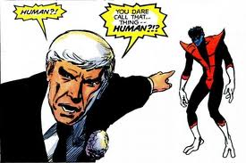
Evening Contemplation
Question: is it part of human nature to destroy people who are different than us?

Slide 4
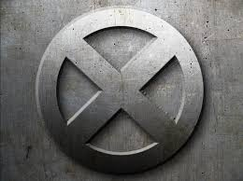
“X” Symbol
Symbol of inversion
The interplay of opposites
One quality gives rise to its opposite; death giving rise to life
Good to evil
It also signifies that “every true analogy must be applied inversely," as above, so below

Slide 5
Let’s Begin with the End (of the book):
This is a book that seems to despair the vision of reality presented by Stryker and his world
There is no middle ground left between the dreamy utopia Stryker’s world & the ironically "ideal" society of the mutants
Question we are invited to ask as the reading subjects: Who do we identify with more?
This is suggested by the discovery of Stryker’s follower Anne as a mutant
Is there a moral to this Book?

Slide 6
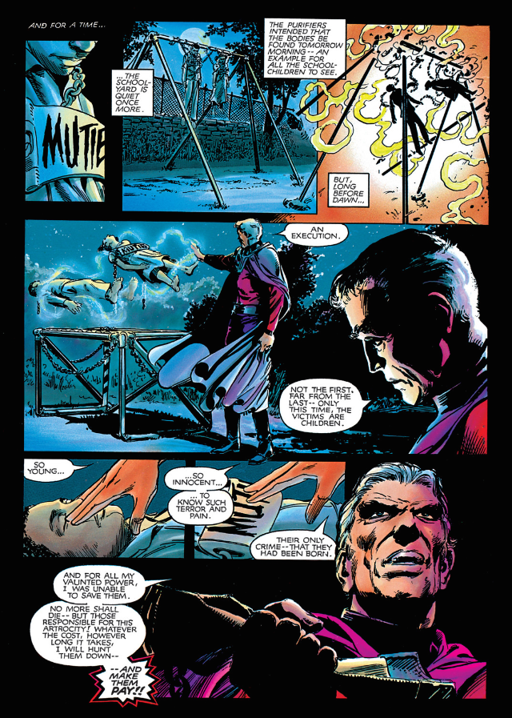
So it Begins…
Why open the book with this violent image / incident?

Slide 7
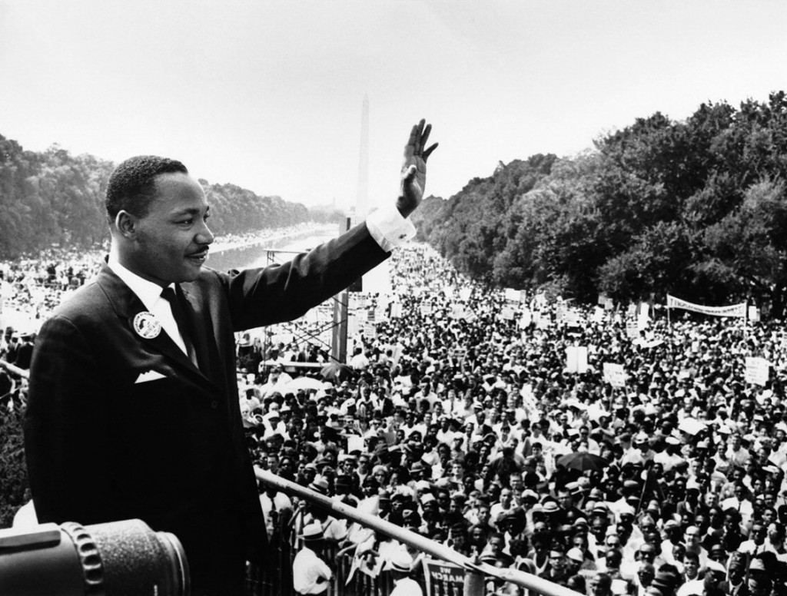
Martin Luther King Jr.
Not only spoke against the violent extremists / fundamentalists (the Stryker figures)
Luther Jr. spoke against everyone who participated in the system as part of society—everyone is complicit
“We will have to repent in this generation not merely for the vitriolic words and actions of the bad people, but for the appalling silence of the good people” (Letter from Birmingham Jail)

Slide 8
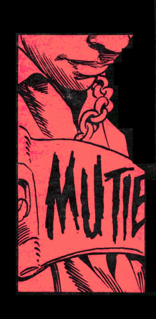
The Mutie:
Metaphor for every persecuted subgroup
A network of people displaced under the threat of violence
Multicultural and multiracial perspective
They shed light on marginality in America
This graphic novel is heavily invested in the countering of the racist perspective
They shed light on the myths about pluralistic and multicultural societies
Fears of the immigrant other penetrating and invading the white nation
The “mutie” is a way to assert marginal subjectivity and identity

Slide 9
Muties: The “Other”
Debate: are muties human?
Generic term for mutants is “homo sapiens superior”—an ironic reference (scientific classification)
Focus on their differences as a species; their “otherness”
Means that mutants are apart of the homo sapiens species
Subspecies superior vs human (homo sapiens sapiens)

Slide 10
The Other (to the self)
Represents everything the self disavows
Everything you don’t like inside yourself onto the other
What one hates in the other, one hates in himself
Forms of othering: beastializing; effeminizing; sexualizing; demonizing; infantilizing
When you construct the other, you construct yourself
Other is referred to as the subaltern, subhuman
The other cannot exist as an equal
On the fringes of society (periphery)

Slide 11
Mutation
Mutation is a natural phenomenon
Moving beyond the human
Mutation (birth defects) as a movement forward in human evolution
Seeing into the future (a post-human future)
Mutation as a key to survival

Slide 12
Mutation & Biology
Magneto believes that all mutants are superior to non-mutants-“homo superior”
X-gene—everyone has it; all humans were endowed with it by Celestials but it is non-active
Humans are the result of deactivated X-gene
Mutants who lose their powers therefore degenerate from mutant to human, but X-gene is still there
Thus, are mutants really a different species or are they the same species as normal humans with active X-genes?
Therefore, what makes them superior?
Are they not just humans that have been enhanced?

Slide 13
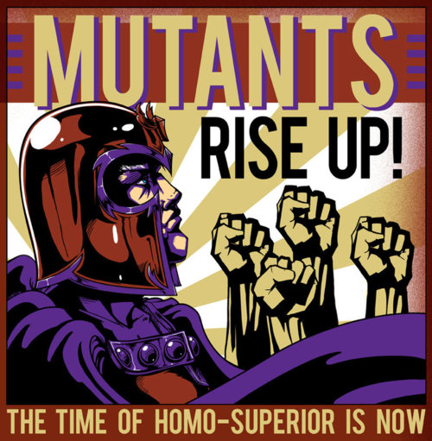
Mutation, Biology, and Morality
Magneto: elitist and separatist
Is he justified in his views that mutants are more superior b/c they are higher in the process of human evolution and have superior abilities?
Mutants are to humans like humans to animals

Slide 14
Moral community
What about when you place the individual in a moral community?
A specific set of characteristics determine individual membership (psychological, social)
Mutants exhibit the characteristics to be apart of the moral community
Therefore, they should be treated equal to others
The Mutant Registration Act is therefore immoral
Magneto is therefore immoral
Is he just another flawed human being?

Slide 15
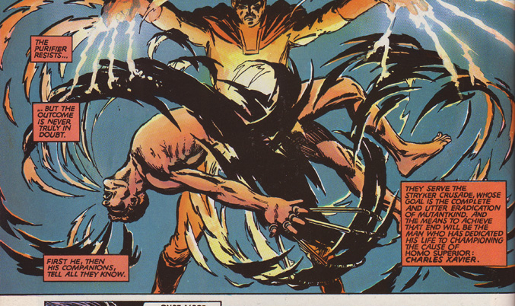
Magneto

Slide 16
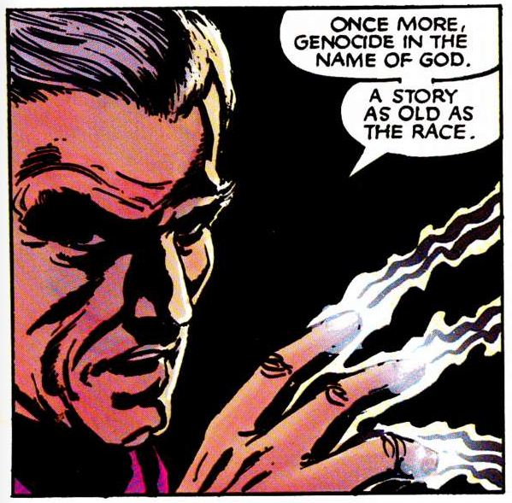
Magneto: “I wept over too many graves”
Magneto: tragic antihero (history and legacy of oppression) he believes they cannot co-exist—his solution: separation
Openly antagonistic
A very driven character—pursuing a new type of persecution
Graphic comparison between these outcasts and others who are real
(anti-semitism)
Magneto makes history accessible to us—but is he not just continuing the ever-spiraling cycle of hate and violence?
The connection between prejudice and Hitler’s final solution

Slide 17
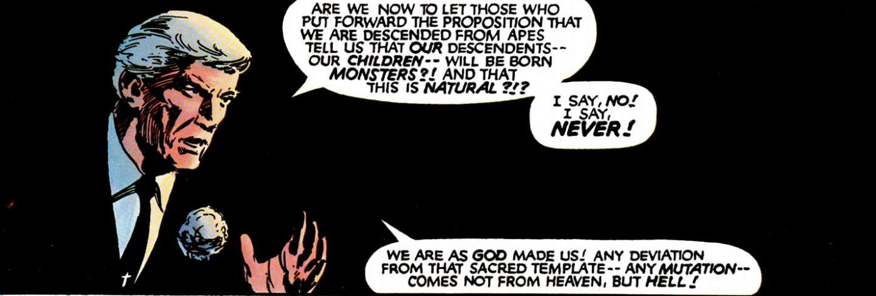
Reverend William Stryker

Slide 18
Religious Point of View: Stryker
Spokesperson for American right-wing Christian mores
Claremont’s critique: not religion itself but the way people interpret it
Claremont’s approach: “Charles was speaking to people’s ideals, Stryker to their fears”
Shows that fundamentalism reveals itself in many places and forms
Novel demonstrates different perspectives
Deals with real issues that surfaced in the aftermath Vietnam, the cold war, the holocaust, etc.,
Stryker adopts the language of division: it is the language if imperialism, nazism, fascism,---this language works to shift the realities of mutants (example in text—breakdown of the word)

Slide 19
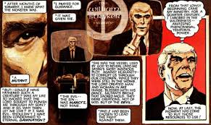
Flashback

Slide 20
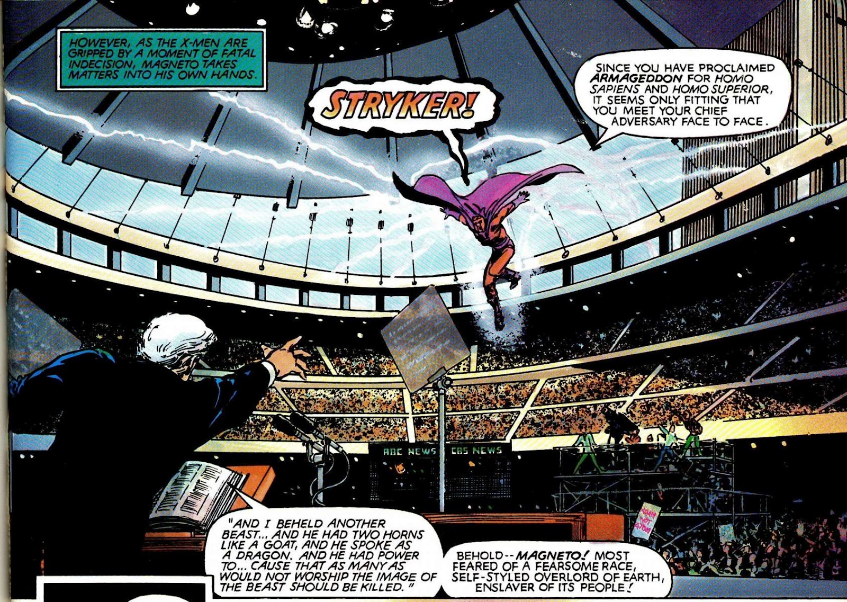
Reverend Stryker’s Garden Sermon
Culture---suggests a crisis of faith
Loss of order—ending gives a sense of hysteria
Obsessed with finding what’s normal—to gain identity (national and personal)
Common denominator: a spectacle
Staging of the spectacular—theatrical
Designed to stun the audience
Linguistic spectacle (verbal field is focus)
Power is a performance
Intersects audience and actor (Stryker)

Slide 21
Garden: symbol
Ironic symbol?
Paradise
Fields of the blessed
At the center of garden is life-giving tree, fruit or flower-reward of he/she who finds the center
Symbol of the soul
Symbol of tamed and ordered nature
Symbol of life
Garden of Eden—he quotes from Genesis (allusion to Christian Myth)

Slide 22
Back to X-Men Symbol
Solar Mobility
The wheel of change
The wheel of fortune?
Christian church

Slide 23
Magneto and Stryker
Is Magneto caught in the very system he seeks to dismantle?
Is Magneto less dangerous?
Stryker is about a culture that needs to protect itself through orthodoxy –about the need to discipline, control, regulate
Focus on techniques of control and surveillance
When a culture peripheralizes things—it places it on the margin

Slide 24
Magneto / Professor X Binary
Magneto
Professor X
Humans and mutants cannot co-exist
Voice of radicalism and extremism
Power: magnetize metal
Concentration camp survivor
Arrogance, unruliness, violence
mobility
Embodies transgression & expansiveness
Movements & gestures are big & sweeping
Preaches peaceful coexistence
Voice of rationality and moderation
Power: telepathy
Physical disability
Balance, modesty, calm
immobility
Embodies restraint & containment
(order)
Movements are small

Slide 25
Ideology
Ideology defined:
1. refers to the set of overarching social values, images
2. and beliefs of a society that remove individuals of their true knowledge of their true role in society
3. naturalizes artificial forms of behavior to the point where people believe this form of behavior is natural

Slide 26
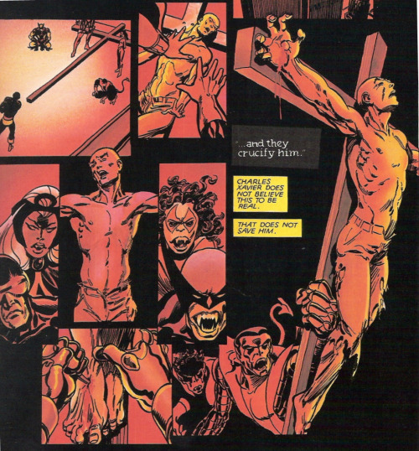
Prof X: Savior figure
Messainic figure
His crucifixion (fears about his people turning against him)—projection of his fears?
Self-sacrificial

Slide 27
Professor X: Mind Control
Celebration of the power of the mind (not the body)
Omnipotent
mind and body split
His imprisonment foregrounds the split in his psyche;
The unconscious (fears) and conscious (energy that threatens control)
he is used the display the penetration of Stryker’s ideologies
Strategies of mind control used for undesirables
He cannot transform via the body—he is fixed
But the X-men represent an extension of his body—they are his shape shifters—that is his way of transgressing authority

Slide 28
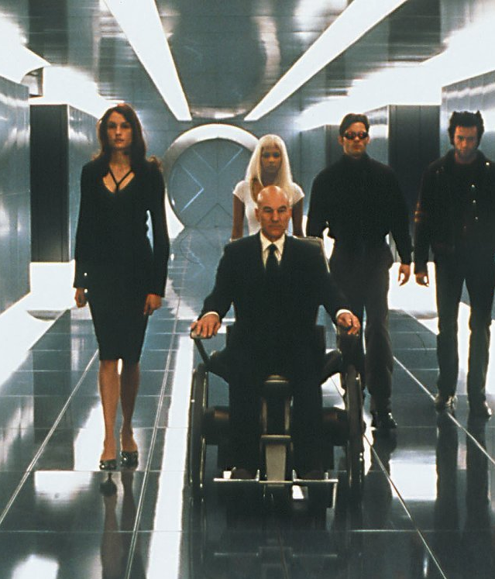
Professor X- Disability
Another minority movement in the comic (disability culture)
His disability: a deconstruction of the perfect body
Wheel chair as tool, a form self-expression, an extension of identity/self, a lived experience, a fashion identity?
A configuration of difference (via disability)
A hybrid figuration (man/machine)
A sign of “other than the norm”
Not a sign of weakness or inferiority
Problems: is he bound by it? in his wheel chair, is he contained, deeply reserved, restrained?

Slide 29
Family Metaphor
Family substitute fantasy (vs individual)
Mutants & Magneto’s brotherhood brought together as a family (forced)
Difference to regular family: they are together in service of a higher purpose
Represents a fantasy about finding your real family
Romanticized fantasy
Need a family like me (not the one you are born into)
X-men members of a threatened affinity group
For the reader, it provides membership and security
X-men reimagines, twists the fantasy and our understanding of reality—this is what makes superhero stories endure

Slide 30
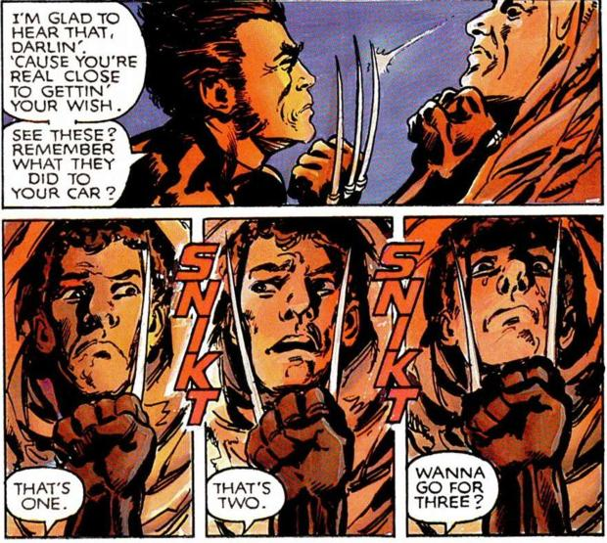
Wolverine (ch.2)
“We’re glad he is on our side. The anger has been channeled and has transcended mere petulance and become the salvation of all that is good and well-intentioned in us. Wolverine takes our anger and uses it as a weapon, and in doing so, purifies us all. He kills for our sins. And it is good (Danny Fingeroth, 137).

Slide 31
Wolverine: The Star Attraction
First appeared in the comic world as an adversary of Hulk-joined X-men in 1974
Loner persona—romanticized the introvert; solitary existence
Lack of restraint and self-control.
The question of Wolverine’s identity ---is he an authentic mutant or a real human—his condition of being is in question
Another vigilante hero archetype—anger-fueled character
Justice and personal vengeance
Justice is not selfless
Meeting violence with overwhelming force
The need to tame Wolverine’s violence/aggression
Dark past; unknown origins

Slide 32
Wolverine—aka Logan
Expression of anger—of the most extreme manner produced in comics
Sparse memories of the past
He know he is someone’s victim but he doesn’t know who the perpetrator is
rage-inciting
Backstory: implantation of an “adamantium” metal skeleton
Maintains audience sympathy—how?
He is capable of love, hate, loyalty, and friendship; rage does not define ALL of him
His goal is to protect his substitute family
Big brother quality: protector and fighter for all persecuted

Slide 33
Major Themes
Heroism (mutants; any man)
Justice
Power
saviors,
the Apocalypse
the Beast
Evil (individual and societal—comes in the form of racism and other prejudice)
Vigilantes
the American Way
Nonviolence
Collisions—can also be thought of a cross-fertilizations or hybridizations (social; religious; class; adults and children; male and female)

